Slide 1

AnyInfo
-All information at one site
Team 7
SHRESHT

Slide 2

Problem Statement
-General public service
Why can’t we find all different places at one site???
Is it possible for a person to explore different places in a faster and easier way??

Slide 3

Solution!
In this busy world people are having hectic schedule.. so, for availability of all kind of general information such as schools, hospitals, malls, restaurants……..at one place!
Here comes our website, AnyInfo

Slide 4
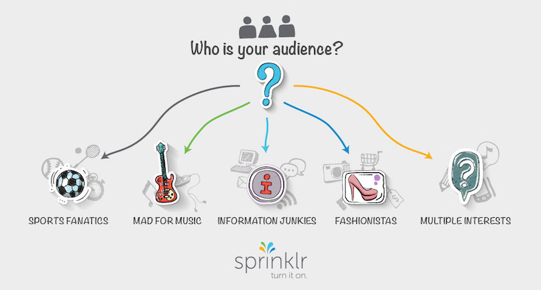

Target Audience
It is for all kind of people which includes
travellers, information junkies, studious,
shopaholics…etc
Market Value

Slide 5
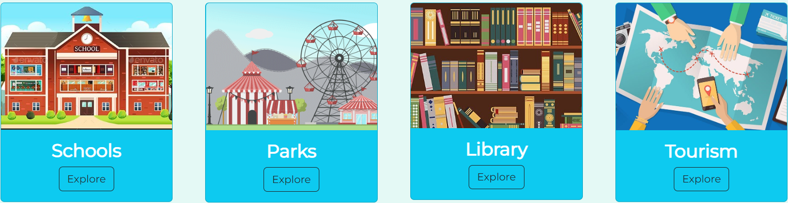

Unique Features
Easy Navigation and Accessible.
Organising the information by Cards.
Grabing the attention by GIF’s.
Upgrading the page through Feedbacks.

Slide 6
Tabs
Home Page
Login Page
Restaurants
Hospitals
Malls
Police
Schools
Parks
Library
Tourism
Feedback Form

Slide 7
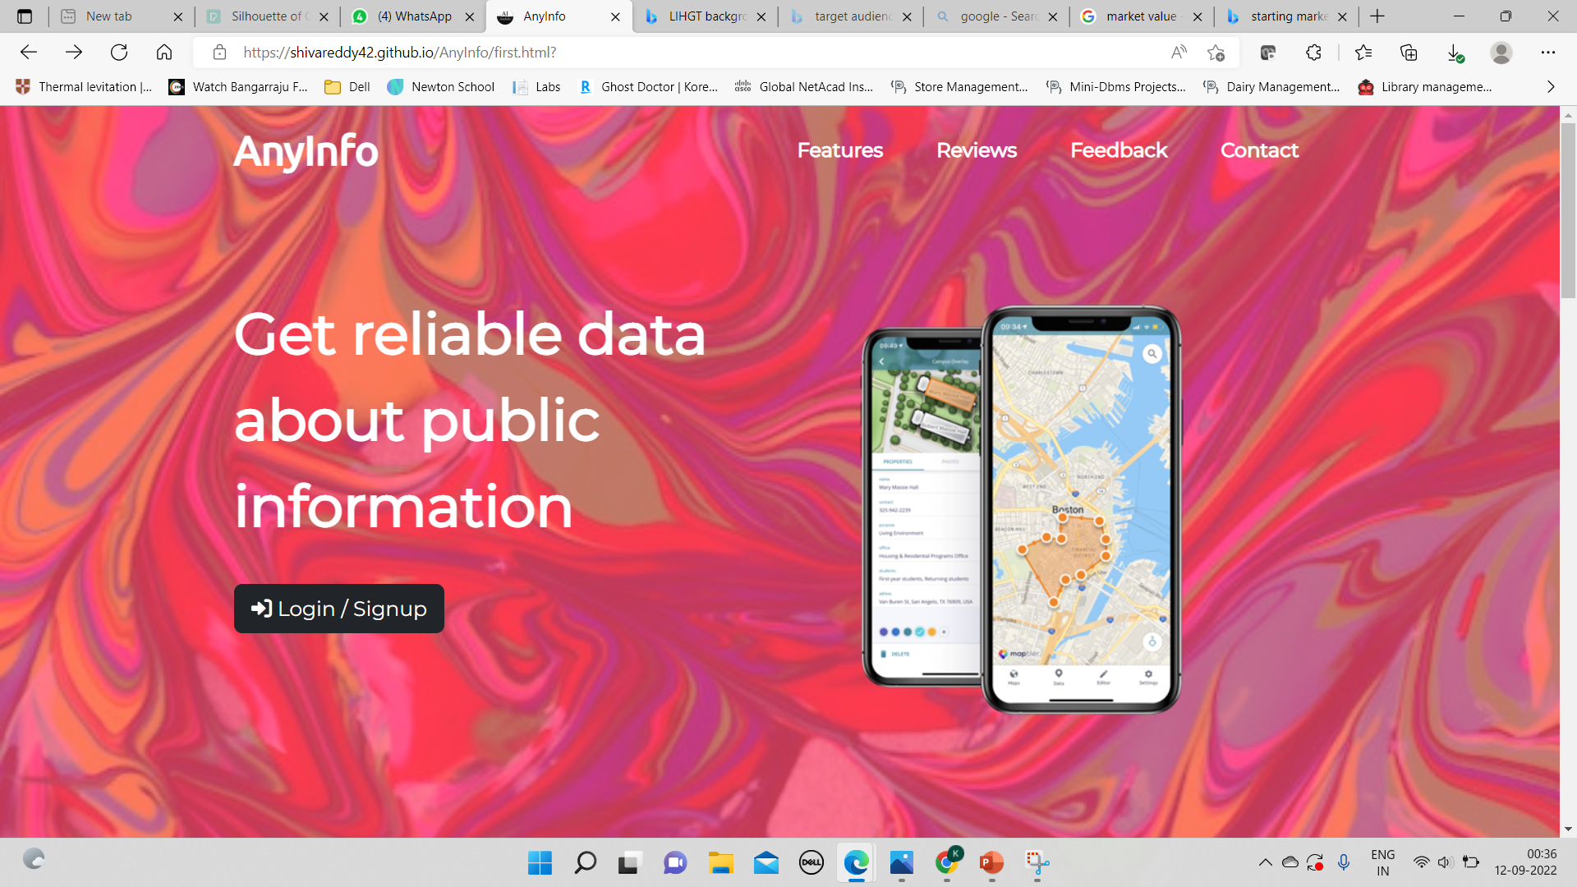
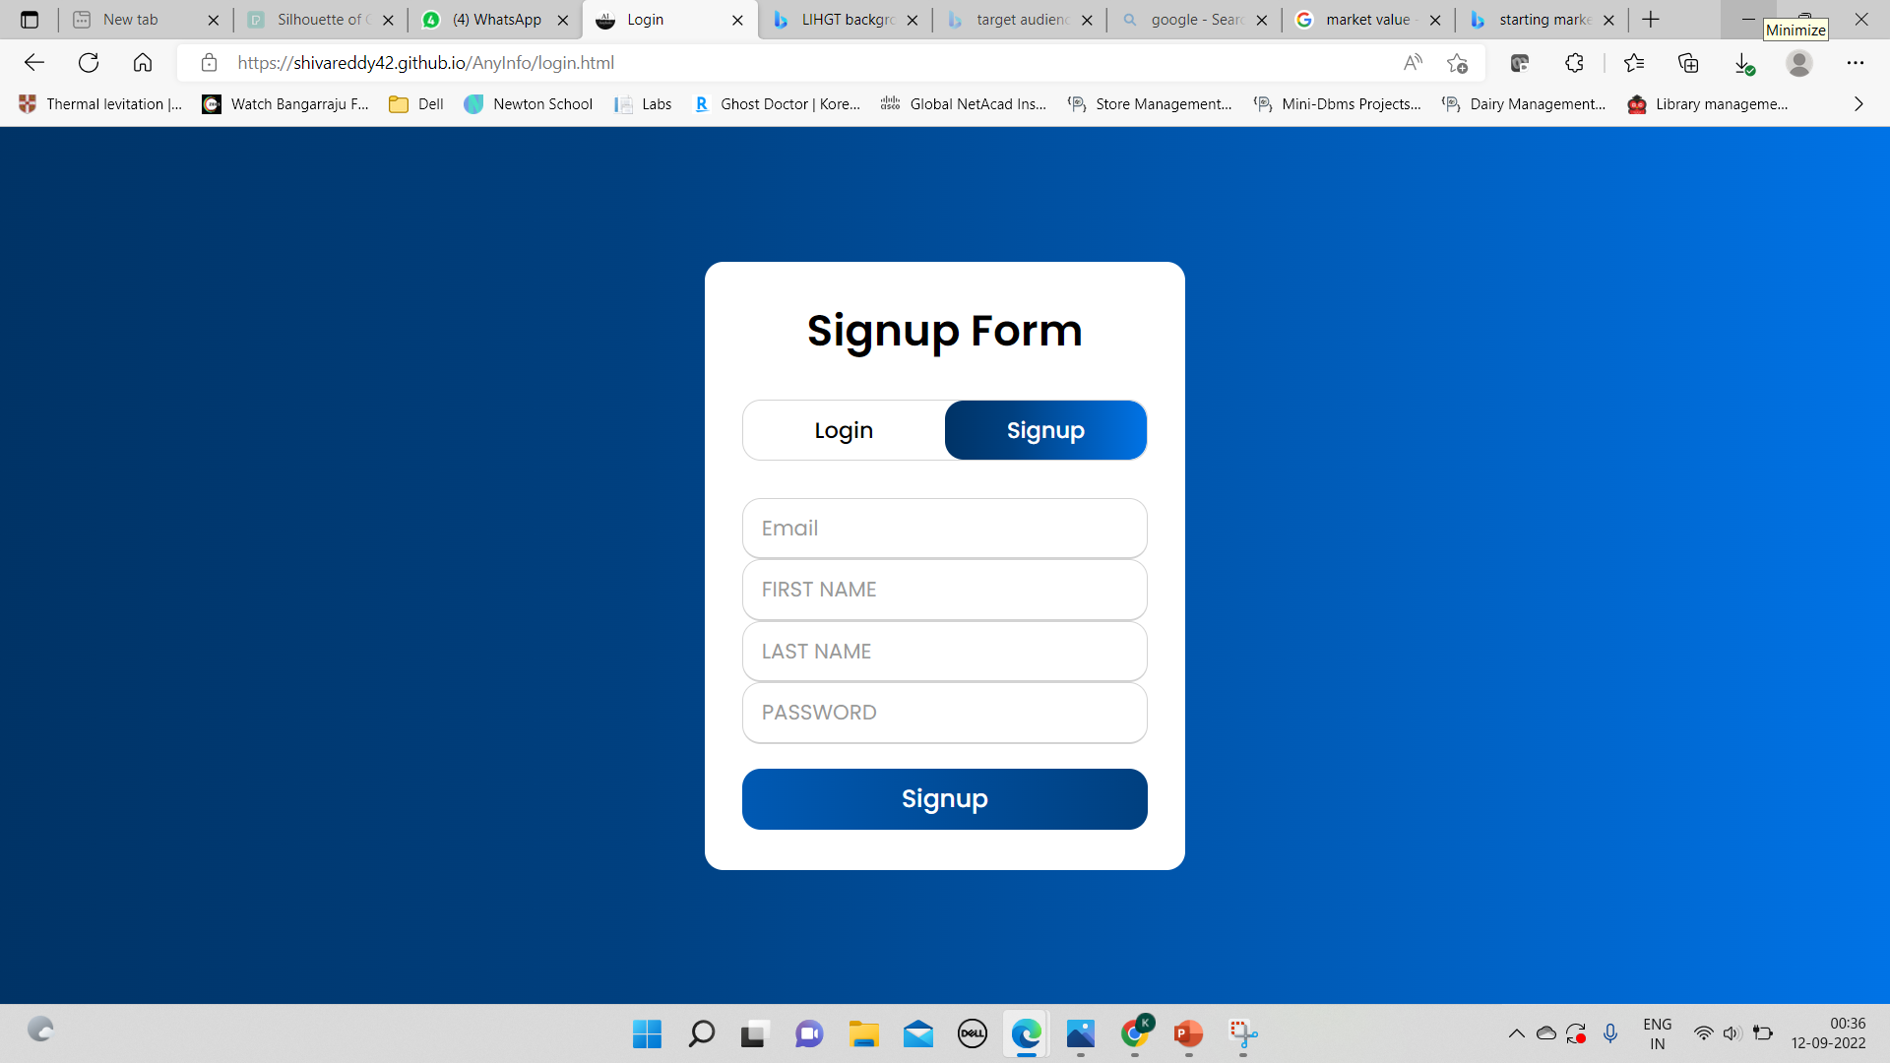
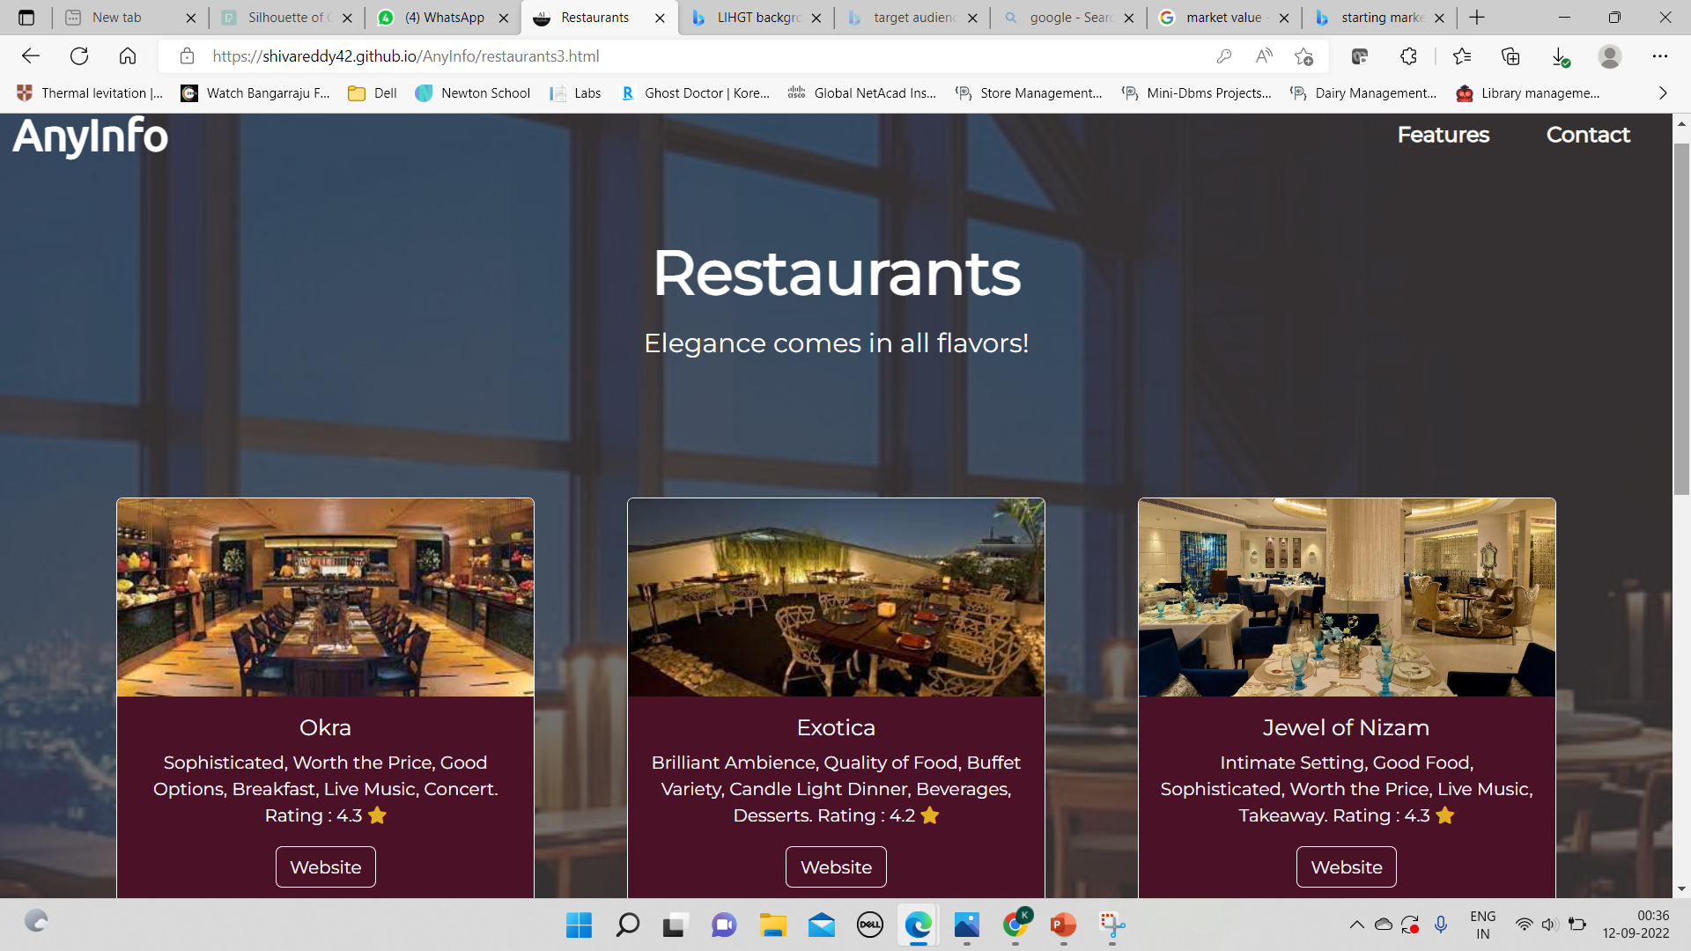
Sample Visuals

Slide 8
TEAM
T. Anu Shree
K. L. V. R. S
B. Rishitha
P. Shiva Reddy
P. Dhruvateja
Passionate
Creative
Amiable
Ambitious
Focused

Slide 9

conclusion
Our AnyInfo page is useful for all catogeries of people who can access different zones of places like Restaurants, Parks, Malls, Schools, Hospitals, Police Stations, Libraries and Tourist places in an easier, faster and

Slide 10

@https://shivareddy42.github.io/AnyInfo/

